Slide 1

CMR COLLEGE OF ENGINEERING & TECHNOLOGY
Kandlakoya, Medchal, Hyderabad - 501401
Department of Computer Science and Engineering
Neural Style Transfer
Name of the students:
M.Pavan- 20H51A05H9
P.Neethika-20H51A05J2
Under esteemed guidance of
Dr.S.Siva Skanda
Associate Professor and HOD

Slide 2
Outline
Abstract
Introduction
Literature survey
Existing system
- Problems in existing system
Research Objective of Presentation
Problem Definition
Research work
- Proposed system architecture
- Methods
- Comparison of Proposed system with an existing system
Performance Measure
Results
Conclusion
Future Work
References
Notes:
2

Slide 3
Abstract
Notes:
3

Slide 4
ABSTRACT
The problem statement for the proposed project, Neural Style Transfer, is to design and implement an efficient deep learning model for style transfer, aiming to combine the artistic style of one image with the content of another image(content image).
We came with a solution to design and implement an efficient deep learning model for style transfer.
This model takes a content image ‘C’ and a style image ‘S’ and merge both images to produce a new image that contains the content of image ‘C’ and the style of image ‘S’. This can be implemented by neural style transferring using deep learning which involves transferring the artistic style of one image onto the content of another, resulting in creative and visually appealing images as outputs. It will be implemented through Convolutional Neural Networks(CNNs), utilizing pre-trained models. The process involves extracting features from both content and style images through pre-trained network, pre-processing of images, optimizing a generated image to minimize content and style loss and iteratively refining the results.

Slide 5
INTRODUCTION
Notes:
5

Slide 6
Introduction
In this project, we will explore neural style transfer using deep learning. The neural style transfer involves taking a content image C and a style image P and combine them to produce a new image that has the content of C and the style of P.
Style transfer is a fascinating field that combines art and technology, allowing us to transform the visual appearance of images in creative and unique ways.
In this project, we explore the neural networks and deep learning to seamlessly blend the artistic style of one image with the content of another, producing captivating and eye-catching results.
Notes:
6

Slide 7
Literature Survey
Notes:
7

Slide 8
Existing system Comparison Table
S.No | Authors and Journal Name& Year of publication | Problem Statement | Name of the Proposed solution/Method | Solution | Remarks
1 | Leon A. Gatys, Alexander S. Ecker, Matthias Bethge, IEEE, 2 Sep 2015. | In fine art, especially painting, humans have mastered the skill to create unique visual experiences through composing a complex interplay between the content and style of an image. Thus far the algorithmic basis of this process is unknown and there exists no artificial system with similar capabilities. | A Neural Algorithm of Artistic Style | Here we introduce an artificial system based on a Deep Neural Network that creates artistic images of high perceptual quality. The system uses neural representations to separate and recombine content and style of arbitrary images, providing a neural algorithm for the creation of artistic images. | High computational cost, limited control, and artifiacts.
2 | Jun-Yan Zhu, Taesung Park, Phillip Isola, Alexei A. Efros, IEEE, 24 Aug 2020 | Image-to-image translation is a class of vision and graphics problems where the goal is to learn the mapping between an input image and an output image using a training set of aligned image pairs. However, for many tasks, paired training data will not be available. | Unpaired Image-to-Image Translation using Cycle-Consistent Adversarial Networks | We present an approach for learning to translate an image from a domain X to a target domain Y in the absence of paired examples. Our goal is to learn a mapping G : X → Y such that the distribution of images from G(X) is indistinguishable from the distribution Y using an adversarial loss. Because this mapping is highly under-constrained, we couple it with an inverse mapping F : Y → X and introduce a cycle consistency loss to enforce F(G(X)) ≈ X. | Lack of fine grained control, generation of unrealistic results in complex scenarios.
Notes:
8

Slide 9
S.No | Authors and Journal Name& Year of publication | Problem Statement | Name of the Proposed solution/Method by authors | Solution | Remarks
3 | Justin Johnson, Alexandre Alahi, Li Fei-Fei, IEEE, 27 Mar 2016 | We consider image transformation problems, where an input image is transformed into an output image. Recent methods for such problems typically train feed-forward convolutional neural networks using a per-pixel loss between the output and ground-truth images. Parallel work has shown that high-quality images can be generated by defining and optimizing perceptual loss functions based on high-level features extracted from pretrained networks. | Perceptual Losses for Real-Time Style Transfer and Super-Resolution | We combine the benefits of both approaches, and propose the use of perceptual loss functions for training feed-forward networks for image transformation tasks. We show results on image style transfer, where a feed-forward network is trained to solve the optimization problem proposed by Gatys et al in real-time. Compared to the optimization-based method, our network gives similar qualitative results but is three orders of magnitude faster. We also experiment with single-image super-resolution, where replacing a per-pixel loss with a perceptual loss gives visually pleasing results. | It can struggle to handle wide range of artistic styles effectively, as the models are typically pretrained on a fixed set of artistic styles.

Slide 10
Year of Publication | Author Name | Name of Journal | Title of Paper | Technology Used | Technique Used
2015 | Leon A. Gatys, Alexander S. Ecker,and Matthias Bethge | arXiv | A Neural Algorithm of Artistic Style | CNNs, Feature Extraction, Preprocessing and Post-processing | Content and style separation, Loss functions, Optimization, Feature Maps
2017 | Jun-Yan Zhu, Taesung Park, Phillip Isola, and Alexei A. Efros | paperswithcode | Unpaired Image-to-Image Translation using Cycle-Consistent Adversarial Networks | CycleGAN, CNNs | GANs, Cycle-Consistency Loss, Adversarial Loss

Slide 11
Dataset | Performance Evaluation | Key Contributions | Type of Technique | Your View on the Paper | Architecture(if any)
ImageNet | Artistic Effectiveness, Customizability | Use of CNNs, Artistic Applications, Creative Possibilities | Deep learning based image processing | This paper revolutionized the field of neural style transfer by introducing a method to combine content and style in images using deep learning.
CycleGAN Horse-to-Zebra | Visually appealing images, Consistency, Quality | Cycle-Consistency for Unpaired Image Translation | CycleGAN | It addresses the challenging problem of translating images from one domain to another without requiring paired training data, which is significant Advancement in the field of image-to-image translation. | Novel Architectural Design

Slide 12
Research Objective
Notes:
12

Slide 13
Research objective
The primary research objectives of Neural Style Transfer are:
To improve the visual quality of stylized images produced by neural style transfer algorithms.
To preserve the content of the input image while transferring the style from the reference image.
To provide users with greater flexibility and control over the style transfer process.
To explore and develop various style transfer techniques or more advanced methods, to achieve the desired artistic effects.

Slide 14
Problem Definition
Notes:
14

Slide 15
Problem Definition
In the dominance of digital media and creative content generation, there is a growing need for automated tools that can seamlessly blend the artistic style of one image with the content of another. The problem at hand is to develop a robust and efficient style transfer algorithm capable of preserving the content of an input image while applying the desired artistic style from a reference image. This project aims to address the challenges of creating a user-friendly, real-time style transfer solution that produces high-quality results across various domains, including art, photography, and graphic design.

Slide 16
Research Work
Notes:
16

Slide 17
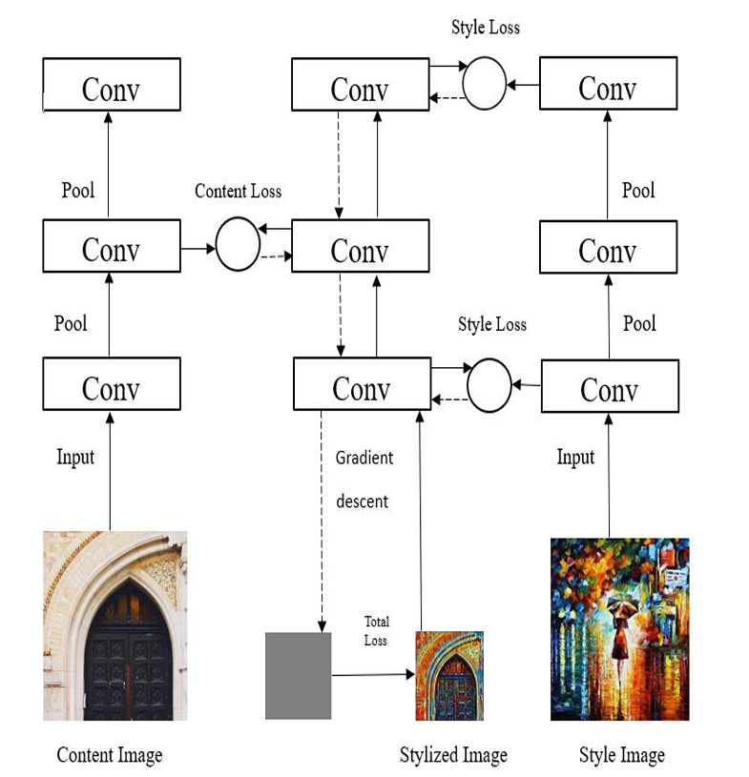
Proposed system architecture

Slide 18
Proposed Methods
Framework Components: The framework consists of two main components: the picture transformation network fW and the loss network ϕ.
Training Objective: The goal is to minimize the weighted combination of loss functions using stochastic gradient descent.
Utilizing Pretrained Networks for Loss Computation: It uses a pre-trained CNN
which is trained for image classification.
Content and Style Losses: The framework uses two main loss functions: content loss that measures the difference between features of the output image and a target content image. And Style loss measures the difference in style between the output image and a target style image.
Total Loss and Training: The total loss is a combination of content and style losses, controlled by parameters α and β. The aim is to minimize this total loss.

Slide 19
Proposed Methods
Convolutional Neural Network (CNN): A Convolutional Neural Network is a type of artificial intelligence system inspired by how the human brain processes visual information. A CNN can learn to recognize patterns and features in images. It does this by breaking down the image into smaller parts, called convolutional layers, and analyzing them to understand what's in the picture. This helps CNNs good at tasks like image recognition, object detection.
Visual Geometry Group 16: VGG-16 is a specific type of Convolutional Neural Network (CNN) that can recognize images. It's called "VGG-16" because it has 16 layers, including 13 convolutional layers and 3 fully connected layers. These layers work together to process and analyze different aspects of an image, gradually building up a detailed understanding of what's in the picture. VGG-16 is known for its simplicity and effectiveness, making it a popular choice for various computer vision tasks, like image classification and object detection.

Slide 20
Performance Measure:
We can measure the performance of neural style transfer by:
Measuring how well the important content and features of the input image are retained in the output.
Evaluating the accuracy of the artistic style from the reference image to the input image, capturing its unique textures, colors, and patterns.
Evaluating the speed of the neural style transfer process and ensuring it can be performed efficiently.

Slide 21
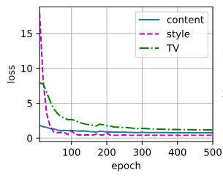
Performance Measure:
The x-axis represents the epoch.
The y-axis represents the loss.
The two lines on the graph represent the content loss(blue) and the style loss(orange).
As the number of epochs increases, the content loss and style loss both decrease. Which results our model is getting better at capturing the content of the content image and the style of the style image.

Slide 22
Result Analysis
The result of a neural style transfer project is the creation of visually striking images by carefully blending the content of one image with the artistic style of another.
These stylized images showcase unique and artistic effects, making them suitable for a range of applications in design, art, and visual content enhancement.
This technology is applicable in fields like graphic design, fine arts, and visual content enhancement, also provides a visually engaging and creative approach to image processing.

Slide 23
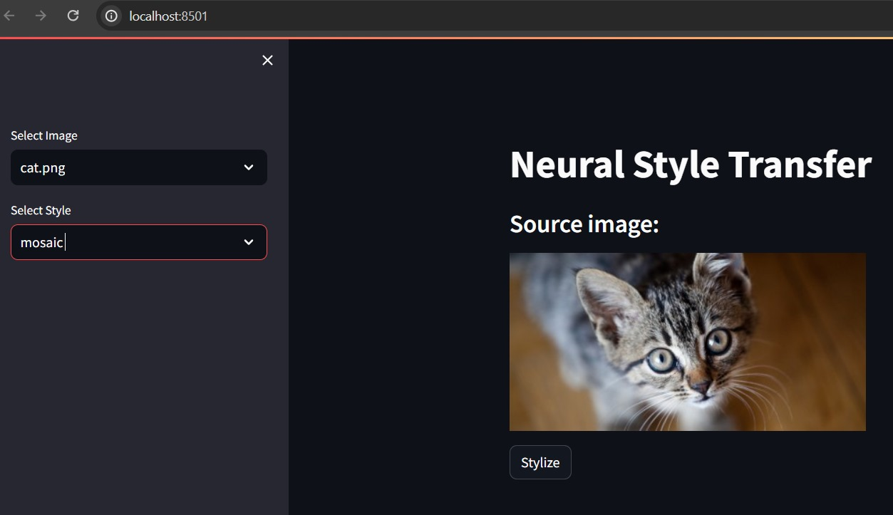
Result Analysis

Slide 24
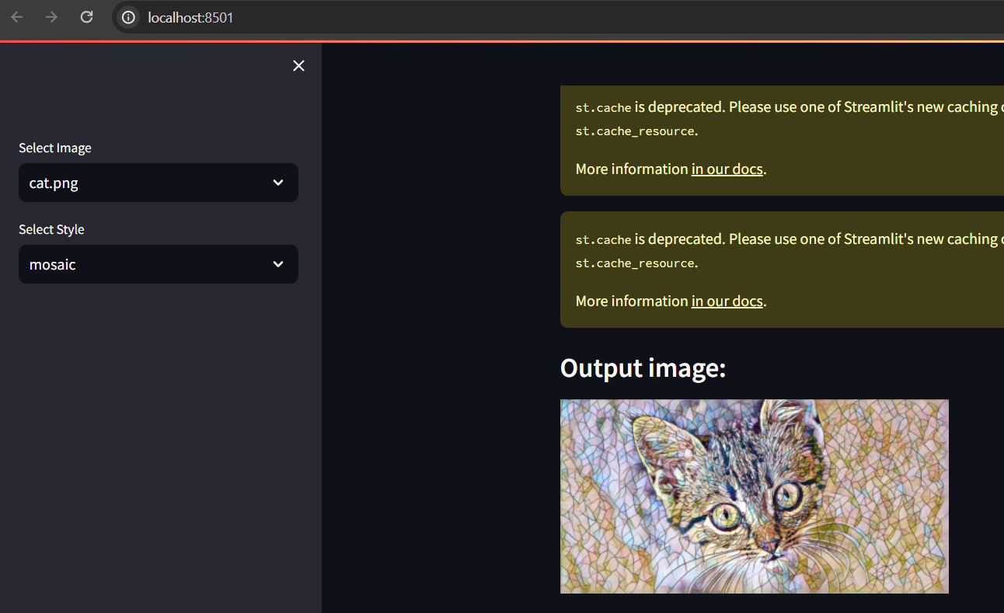
Result Analysis

Slide 25
Conclusion
In conclusion:
This style transfer project has successfully developed an innovative algorithm that allows users to transform their images by blending content with artistic styles.
The project achieved real-time performance, user-friendliness, and high-quality results.
This solution opens up new creative possibilities and practical applications across various domains, marking a significant advancement in the field of digital image manipulation."

Slide 26
Future work
Neural style transfer in future may be seen focusing on developing more advanced algorithms that can be capable of producing higher-quality stylized images with improved accuracy of image in content and style.
In future, there might be a discovery that enables users to interactively control and manipulate the style transfer process in real-time.
In future research, neural style transfer techniques may be able to apply to specific domains and industries, such as fashion, interior design, gaming, or virtual reality.

Slide 27
References
1. Dong, C., Loy, C.C., He, K., Tang, X.: Image super-resolution using deep convolutional networks. (2015)
2. Cheng, Z., Yang, Q., Sheng, B.: Deep colorization. In: Proceedings of the IEEE
International Conference on Computer Vision. (2015) 415–423
3. Long, J., Shelhamer, E., Darrell, T.: Fully convolutional networks for semantic
segmentation. CVPR (2015)
4. Leon A. Gatys, Alexander S. Ecker, Matthias Bethge.: A Neural Algorithm of Artistic Style. (2015)

Slide 28
Thank You!

